Slide 1
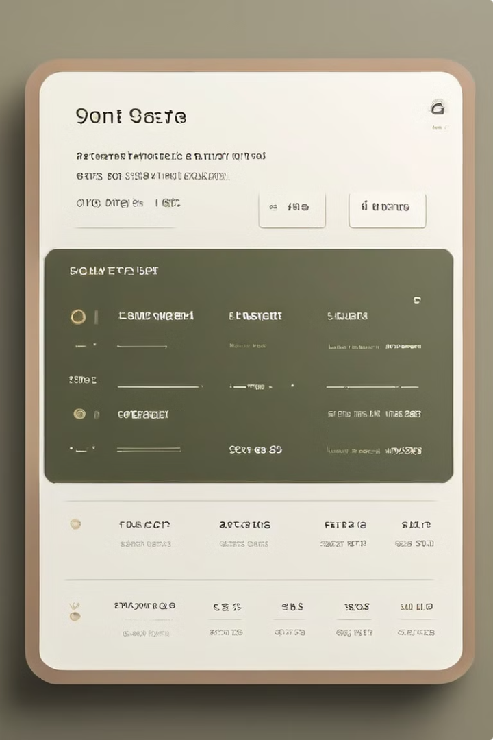
The Summary Writer Tool: A Comprehensive Overview
Welcome to the world of the Summary Writer Tool! This innovative tool uses cutting-edge natural language processing technology to create concise and informative summaries of lengthy texts.
bs

Slide 2

Introduction to the Summary Writer Tool
Purpose
Functionality
The Summary Writer Tool is designed to efficiently extract the key information from long articles, reports, documents, and other text-based content, saving users time and effort.
It utilizes advanced algorithms to analyze the text, identify the most important points, and generate a concise summary that captures the essence of the original text.

Slide 3
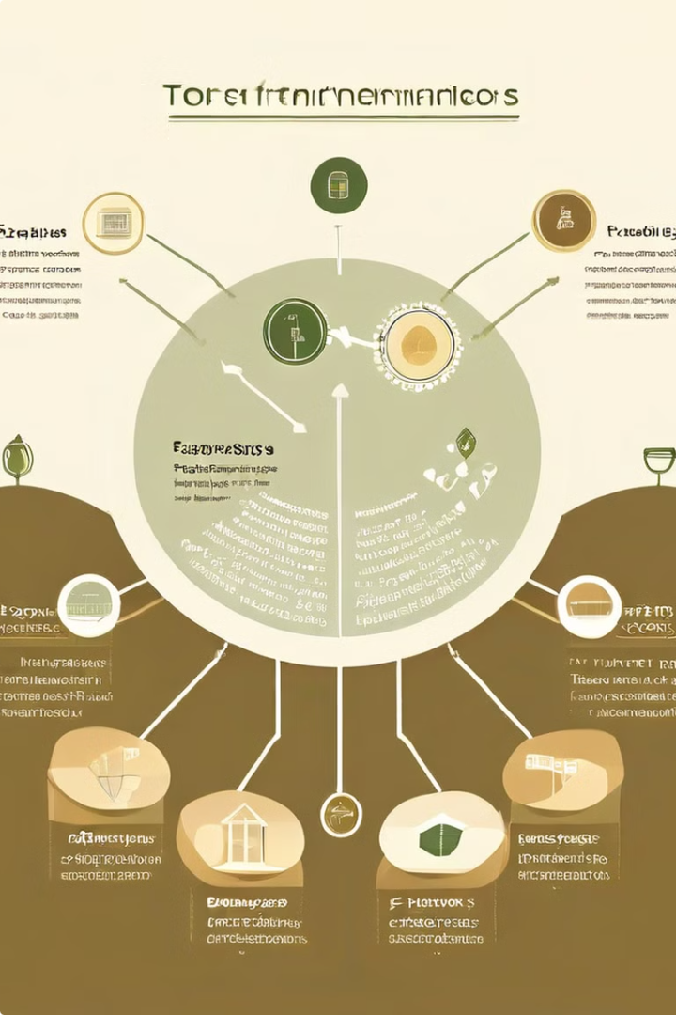
Key Features and Functionality
1
Text Input
2
Summarization Options
The tool accepts text from various sources, including websites, documents, and even audio recordings.
Users can customize the length of the summary, the level of detail, and the style of writing.
3
Output Formats
4
Integration Capabilities
The summary can be generated in various formats, such as plain text, HTML, or even as a downloadable document.
The tool can be integrated into other applications and platforms, allowing users to streamline their workflow.

Slide 4
Benefits of Using the Summary Writer Tool
Time Efficiency
Improved Comprehension
Increased Productivity
Saves time by reducing the need to manually read and analyze lengthy texts.
Provides a clear and concise understanding of the key information in a text.
Allows users to quickly grasp the essence of information, enabling them to make informed decisions.

Slide 5

Target Audience and Use Cases
Students
Quickly summarizing research articles and textbooks
Professionals
Summarizing reports, meeting minutes, and industry articles
Researchers
Extracting key findings from scientific papers and research data
Content Creators
Generating summaries for blog posts, articles, and social media updates

Slide 6
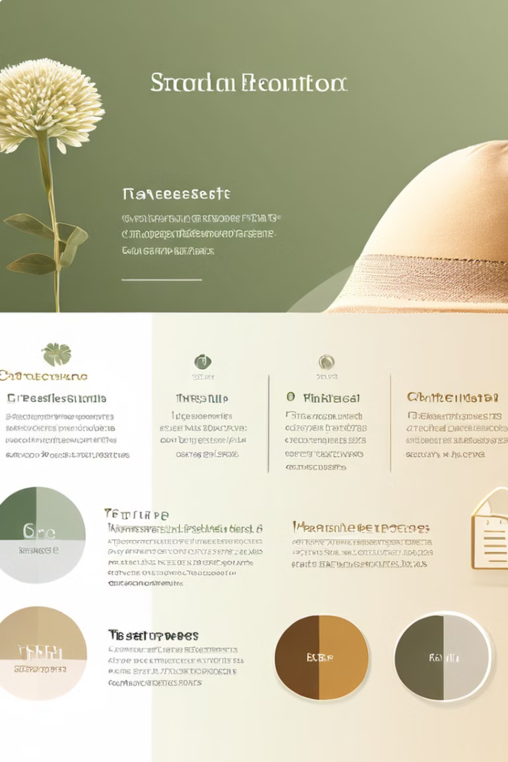



Comparison to Existing Solutions
Traditional Methods
Manual reading and summarizing, which can be time-consuming and subjective.
Existing Summarization Tools
Often limited in functionality, lacking customization options, or having complex interfaces.
Summary Writer Tool
Offers a comprehensive and user-friendly solution, providing advanced features and intuitive design.

Slide 7

Development Process and Challenges
1
Research & Development
The development team conducted extensive research on natural language processing techniques and algorithms.
2
Algorithm Design
The team designed and implemented advanced algorithms to analyze text and generate summaries.
3
User Interface Design
A user-friendly and intuitive interface was created, allowing users to interact with the tool seamlessly.
4
Testing & Refinement
The tool underwent rigorous testing and refinement to ensure accuracy, efficiency, and user satisfaction.

Slide 8



Applications
Education
Business
Research
Students can quickly grasp the key information in textbooks and research papers, aiding their learning process.
Professionals can effectively analyze reports, meeting minutes, and industry articles, gaining insights and making informed decisions.
Researchers can quickly extract key findings from scientific papers, saving time and accelerating their research process.

Slide 9





Future Roadmap and Enhancements
Multilingual Support
Voice Summarization
Data Analytics Integration
Enhanced Security Features
Expanding the tool to support multiple languages, enabling users to summarize texts in different languages.
Adding the ability to summarize audio recordings, making the tool more versatile for various content types.
Integrating the tool with data analytics platforms, enabling users to gain deeper insights from summarized data.
Implementing robust security measures to protect user data and ensure privacy.

Slide 10

Conclusion
The Summary Writer Tool is a transformative technology that empowers users to effectively manage and understand information in our fast-paced world. We invite you to explore this innovative solution and experience the benefits it offers. Join us in shaping the future of information access and knowledge management!

Slide 11


